Slide 1


“E-commerce Website”
Task - 1

Slide 2


E-Commerce Website
E-commerce websites enable businesses to sell products or services online. Customers browse product listings, add items to a digital shopping cart, and proceed to checkout.
Payment and shipping details are securely processed.
The website streamlines the buying process, making it convenient and accessible, and serves as a powerful tool for businesses to reach a global customer base and boost online sales.
LMS Username | Name | Batch
au910020104006 | Anu M | CC2
au910020104017 | Kabilan K | CC2
au910020104022 | Krishnan E | CC2

Slide 3
Task - 1
Creation of SRS & Github
Create SRS : “E-Commerce Website”
Creation & Set-up of Github account
Creation & Hands-on to various commands of Git Bash
Evaluation Metric:
100% Completion of the above tasks
Learning Outcome
Get to know about different lifecycle models.
Understanding importance and how to create an SRS
Knowing various commands of Github
Understanding agile and scrum management techniques for efficient product development

Slide 4
Evaluation Metric:
1.Define Conversion Goals:- Set clear objectives for the percentage of visitors expected to make a
purchase.
2.Calculate Average Order Value (AOV): - Determine the average amount spent by customers
in a single transaction.
3.Evaluate Customer Acquisition Cost (CAC):- Assess the cost of acquiring a new customer in
comparison to their lifetime value.
4.Analyze Cart Abandonment Rate:- Examine the percentage of users who abandon their shopping carts.
5.Review Traffic Sources:- Identify and analyze the sources of website traffic.
6.Assess Customer Retention Rate:- Calculate the percentage of customers returning for
additional purchases.

Slide 5
7.Optimize Page Load Time:- Ensure that the website loads quickly for an improved user experience.
8.Ensure Mobile Responsiveness:- Optimize the website for mobile users.
9.Measure User Engagement:- Track metrics such as time spent, pages visited, and interactions with
site features.
10.Gather Customer Feedback:- Implement surveys or feedback mechanisms to measure
Customer Satisfaction (CSAT) and
Net Promoter Score (NPS).
11.Monitor Inventory Turnover:- Track the speed at which inventory is sold and replenished.
12.Evaluate Return Rate:- Assess the percentage of products that are returned.
13.Identify and Optimize Abandoned Funnel Points:- Analyze specific steps in the user journey
where visitors commonly drop off and optimize those areas.

Slide 6
Step-Wise Description
Define your business model, target audience, and products or services to be sold.
Determine the website's structure and features, such as product catalog, user accounts, and payment processing.
Choose a reliable web hosting service to store your website files.
Create the website's frontend using HTML, CSS, and JavaScript.
Design the user interface, including product listings, shopping cart, and checkout pages.
Set up a server environment to run PHP.
Develop the backend logic for user registration, product management, and order processing.
Create a database using MySQL or another suitable database system.
Implement user registration and login functionality.Ensure data security through password encryption and authentication mechanisms.
Build a system to add, edit, and display products on the website.Create a shopping cart to allow users to add and manage items.Develop a secure checkout process with payment gateway integration.
Test the website thoroughly for functionality, usability, and security.
Deploy your e-commerce website to your hosting server.

Slide 7
Summary of your Task
Creating the frontend user interface (UI) for an e-commerce website is a pivotal initial task in establishing a successful online store. The frontend UI is the face of the website, responsible for engaging and guiding customers through their shopping journey. It encompasses design elements, such as layout, color schemes, and visual aesthetics, as well as the overall user experience. This stage involves crafting product listings, category navigation, and an intuitive shopping cart system. Using HTML, CSS, and JavaScript, developers ensure that the website is responsive, mobile-friendly, and visually appealing. A well-designed UI enhances the user's browsing and shopping experience, fostering trust and customer satisfaction. It also plays a critical role in establishing a brand identity and differentiating the e-commerce site in a competitive market. Consequently, careful attention to detail and a focus on user-centered design are crucial when creating the frontend UI of an e-commerce website.

Slide 8



Assessment Parameter
Gather requirements for the project
add Readme.md file with description of the project
Prepare database design schemas
Check-List
Commit all changes with "first commit"
Get your initial project Structure ready
create a repository on github related to project
Initiate a git repository
Push your changes to github

Slide 9


Submission Github
https://github.com/Anuledger2003/
E-COMMERCE_WEBSITE

Slide 10
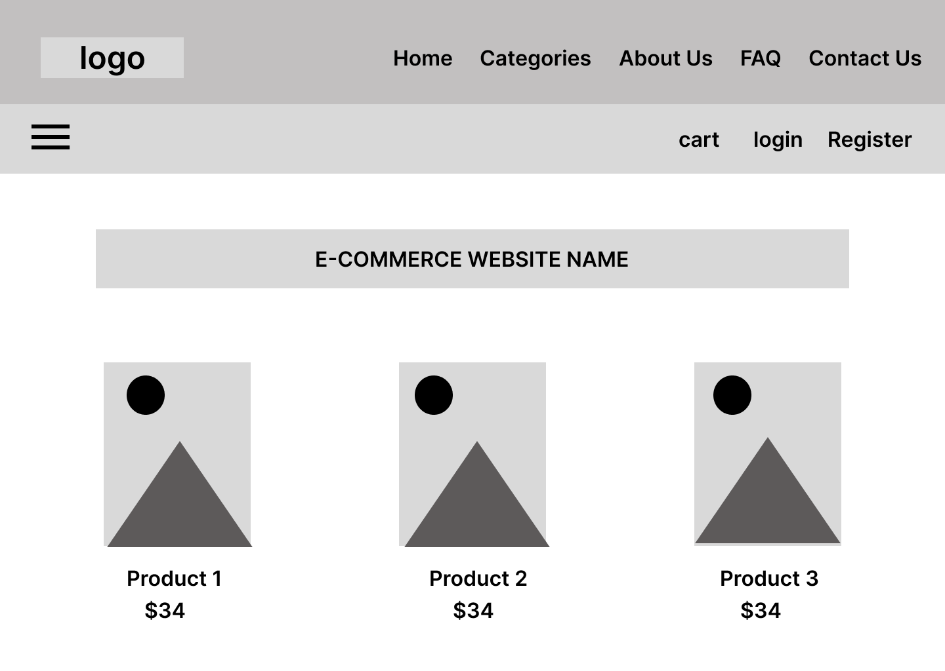
User Experience

Slide 11


